Slide 1
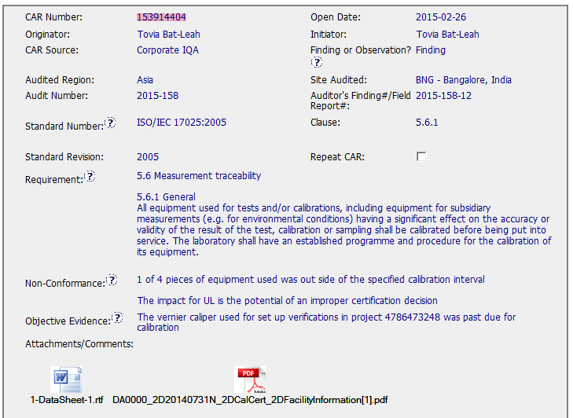
CAR 153914404
Fields filled out appropriately
Good idea to attach the report that the auditor had issues with. A comment could be added like “See attachment in the comments area”

Slide 2
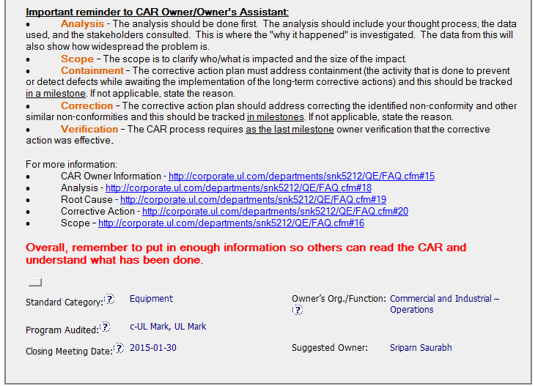
CAR 153914404
Guidance to CAR Owner is complete, accurate and helpful
Standard category is correct

Slide 3
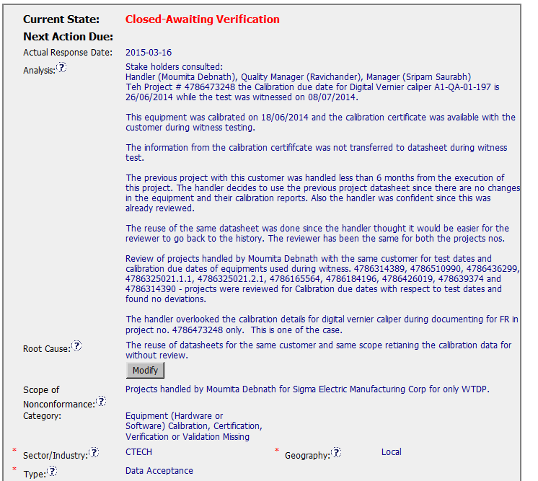
CAR 153914404
The Analysis field is detailed, but is not a good practice to reuse DS
Root cause could be improved

Slide 4
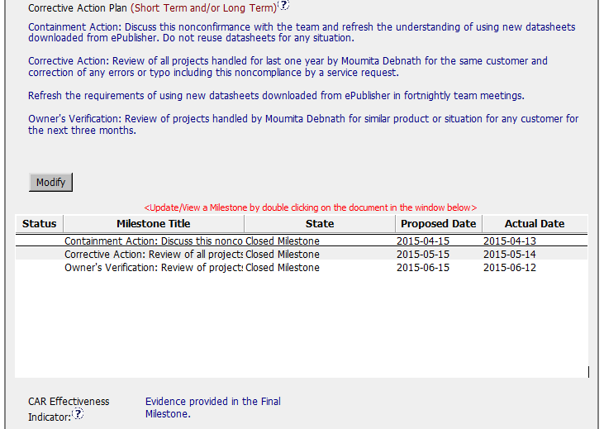
CAR 153914404
Good, contaiment and verification are available as required for findings.

Slide 5
CAR 153914404 - CBS
INTEGRITY: Initiative & Decision Making / Analyzing & Problem Solving
Facilitates progression of the CAR through closure: extensions, escalations, reassignments, etc. (+)
Accurately completes the administrative fields within the CAR such as root cause category, process impacted, geography, etc. (+)
Acts on CARs within the required timeframe (+)
Appropriate ‘category’, ‘type’, ‘geography’ are selected (+)

Slide 6
CAR 153914404 - CBS
COMPETIVENESS: Customer Focus / Achieve Business Results / Flexibility
Assists customers as they address all aspects of the CAR – analysis, root cause statement, milestone, containment, verification, etc. (+)
Verifies CARs timely (+)
Analysis shows clear path to root cause and scope; stakeholders identified (+)
Root cause statement is succinct, reasonable, complete (+)
Corrective actions fix the objective evidence and other problems found; address entire root cause and scope. (+)
(C) Milestones address containment & owner’s verification; completed per milestone expectations(+)
(P) Verification per requirements (+)
COLLABORATION: Leading & Engaging / Teamwork / Communication
Provides pertinent feedback at appropriate times; shares information and keeps others informed (+)

Slide 7
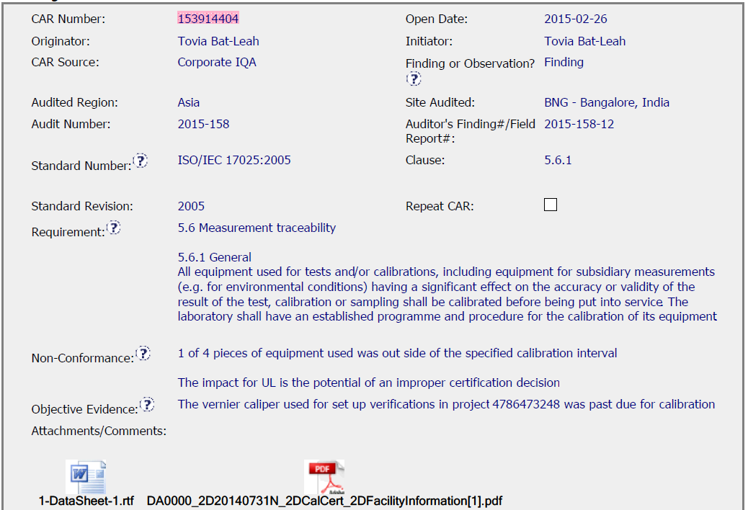
CAR 153914404

Slide 8
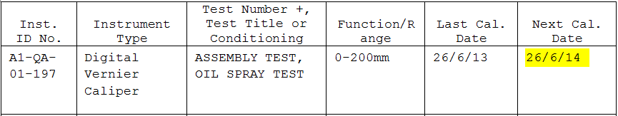
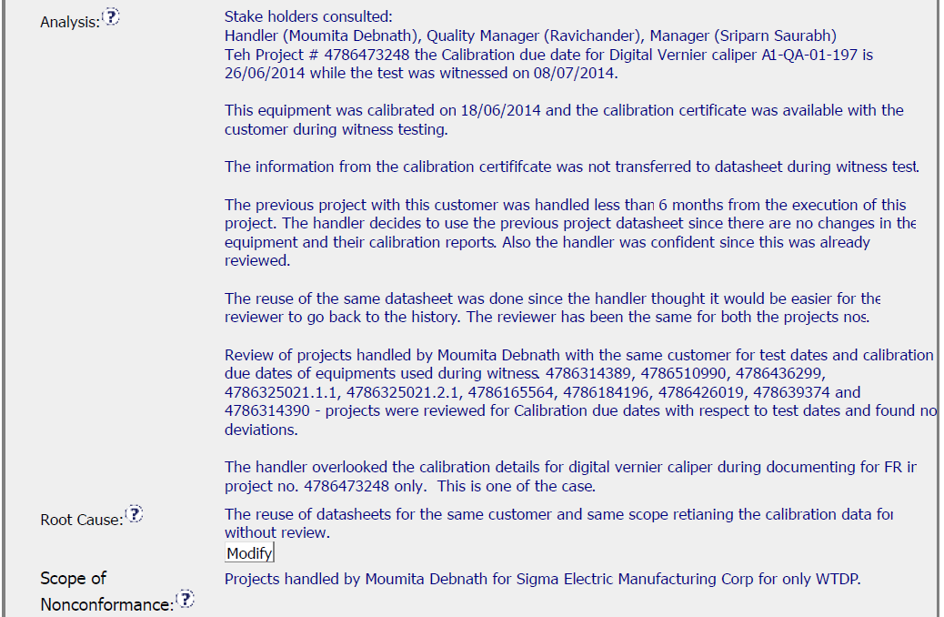
CAR 153914404
Excellent -
1. Stakeholder involved.
2. Clear and reasonable analysis to address the root cause.
3. Additional projects reviewed to know how widespread the nonconformance is.

Slide 9
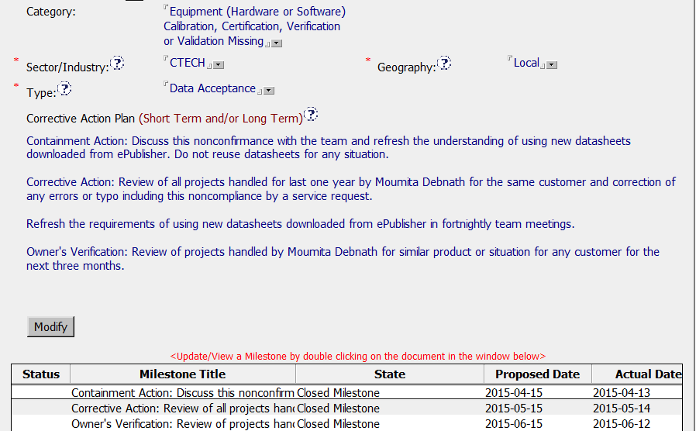
CAR 153914404
Appropriate Category, Type and Geography are selected.
Excellent -
Containment and Owner’s verification are included in corrective action plan and milestone.

Slide 10
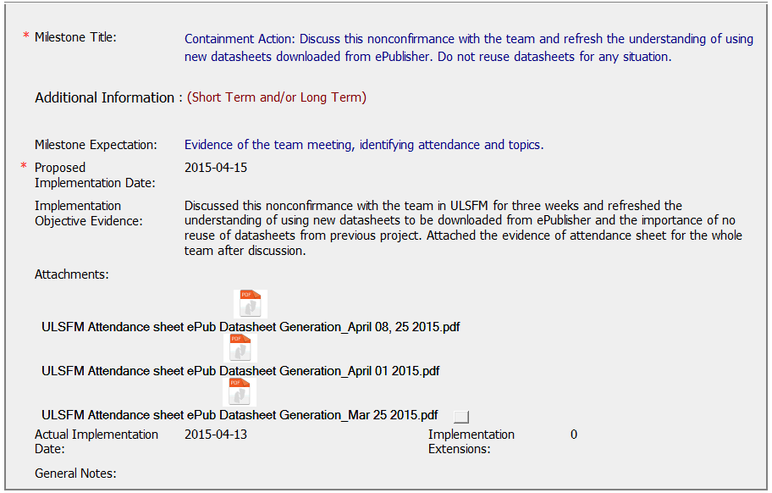
CAR 153914404
Excellent -
Detailed description for action taken, and attendance sheets provided.

Slide 11
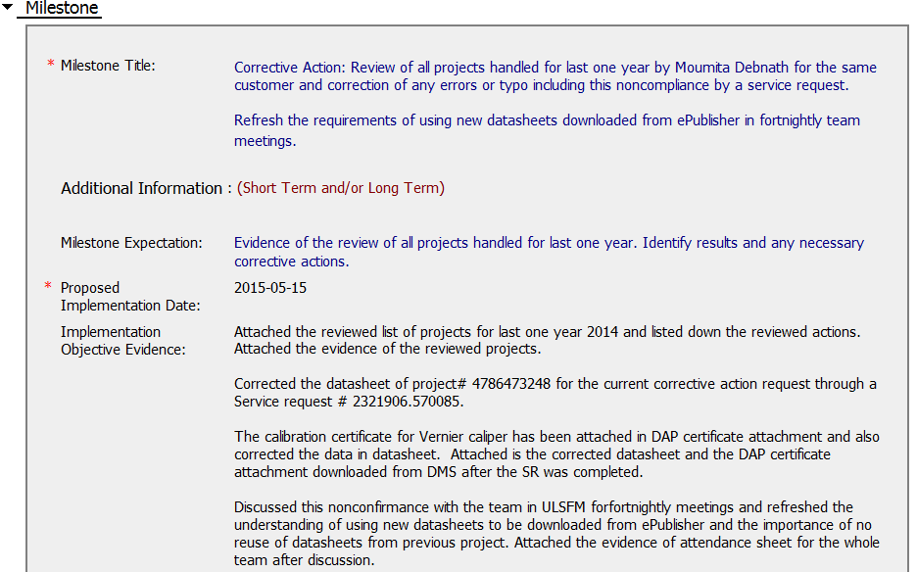
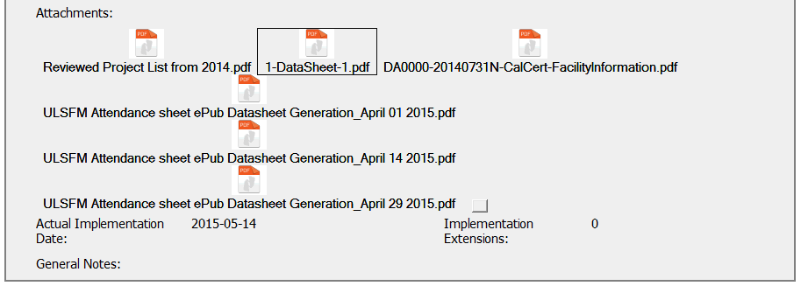
CAR 153914404
Recommendation -
Include DMS screen-shot or link as Datasheet published evidence.

Slide 12
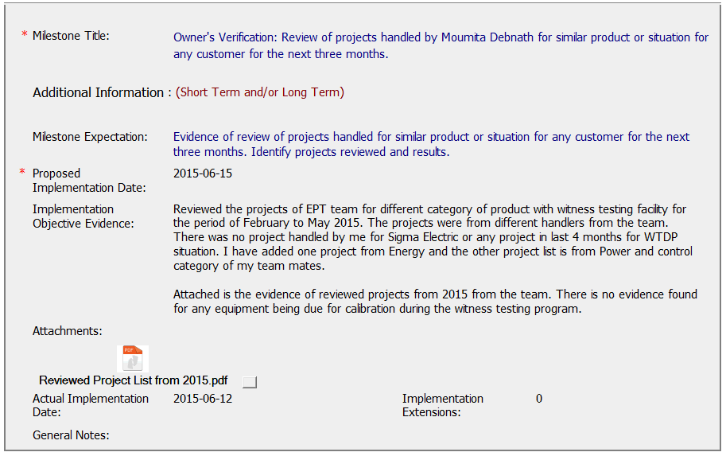
CAR 153914404
Recommendation -
Containment action was completed in April, It’s better to review project after the training date.

Slide 13
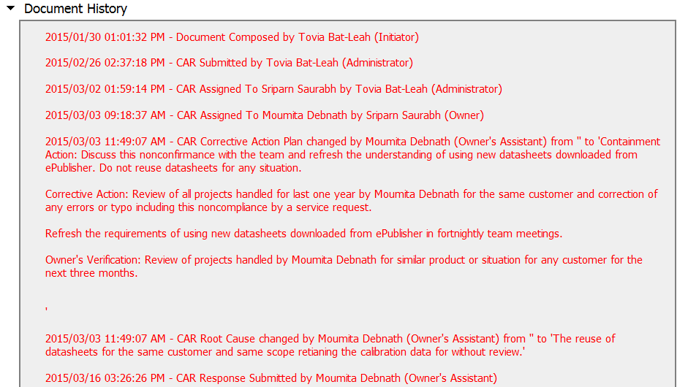
CAR 153914404

Slide 14
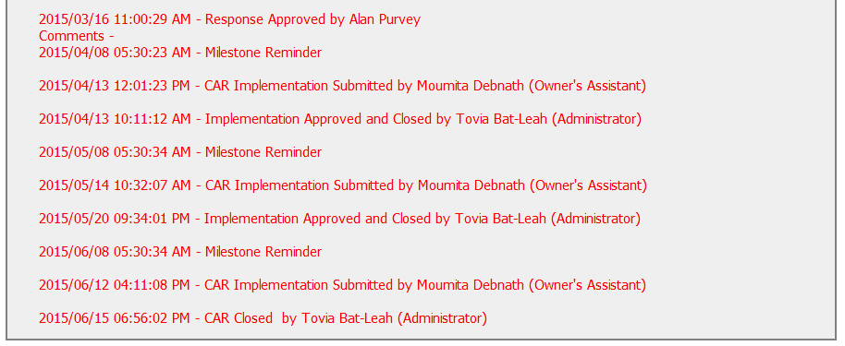
CAR 153914404

Slide 15
CAR 153914404 – CBS Check
CBS Requirements | Excellent | Moderate | Need Improve | N/A
(C) Extensions are within requirement (<30 days, 3 or less) |  |  |  | √
(T) Most appropriate ‘category’, ‘type’, ‘geography’ are selected | √
(P) Facilitates the handling of disputed CARs |  |  |  | √
(T) Acts on CARs within required timeframe | √
(C) Analysis shows clear path to root cause and scope; stakeholders identified | √
(C) Root cause statement is succinct, reasonable, complete (Shows ‘N/A’ for observations) | √
(C) Corrective actions fix the objective evidence and other problems found; address entire root cause and scope. For observations, they do not go beyond fixing the objective evidence | √
(C) Milestones address containment & owner’s verification; completed per milestone expectations |  | √
(P) Verification per requirements |  |  |  | √
(L) Referenced communications are attached as needed |  |  |  | √
(C L) Evidence of communication for overdue/escalated CARs and other pertinent concerns |  |  |  | √
(P) Trains other CAR Champions |  |  |  | √

